Slide 1
IBM University Engagement Project Submission
“Exploring the Power of Agentic AI with IBM Granite and IBM Bob”

Slide 2

Project Tile – ResearchPilot AI
Domain of Project – Education / Research / Artificial Intelligence
Student Name | Recent Passport Photo | Email ID | Mobile number [WhatsApp]
Nikita Deshmukh |  | nikitadeshmukh559@gmail.com | +91 7828029974

Slide 3
Problem Statement -
Problem Statement No.7: Research Agent
The Challenge
Researchers, students, and professionals often deal with scattered academic papers, technical articles, and experimental data spread across multiple platforms. Filtering relevant knowledge, summarizing insights, and keeping track of the latest developments is time-consuming and inefficient. The challenge is not just to collect references but to synthesize, analyze, and generate actionable research insights in real time.
The Objective
Build an agentic AI application that acts as an intelligent research companion. The solution should:
Fuse Academic Sources: Aggregate data from research papers, journals, preprints, and knowledge repositories, then synthesize them into clear, concise literature reviews.
Enable Multimodal Research Input: Accept user queries, notes, charts, or even PDFs, and convert them into structured insights, references, and summaries.
Create a Predictive & Agentic Layer: Highlight emerging trends, detect citation gaps, and predict promising directions for future research in a given domain.
Visualize Research Insights: Provide an interactive dashboard with topic clusters, citation maps, sentiment/trend analysis, and concise knowledge graphs.

Slide 4
Proposed Solution -
Proposed Solution: AI-Powered Research Companion
The proposed solution is a multi-agent AI Research Companion built using IBM Langflow/Orchestrate, IBM watsonx.ai, and Granite Models to simplify research discovery, analysis, and decision-making.
The system uses RAG (Retrieval-Augmented Generation) to retrieve relevant information from academic papers, journals, preprints, and trusted knowledge sources, then generates concise and reliable insights.
Key Agents:
Research Planner Agent – Understands the research question and creates a plan.
Research Discovery Agent – Finds and ranks relevant research sources.
Paper Analysis Agent – Extracts key findings, methods, and limitations.
Research Gap Agent – Identifies gaps and unexplored areas.
Trend Analysis Agent – Detects emerging research trends.
Recommendation Agent – Suggests promising future research directions.
A research dashboard visualizes topic clusters, trends, citation relationships, research gaps, and knowledge graphs.
IBM technologies provide workflow orchestration, model deployment, reasoning, summarization, and research insight generation.

Slide 5
Technology Used
IBM Bob / Langflow / Orchestrate – For designing and orchestrating multi-agent workflows.
IBM Granite Models – For natural language understanding, reasoning, summarization, and insight generation.
IBM Cloud – Provides a secure, reliable, and scalable environment for deploying the application.
RAG (Retrieval-Augmented Generation) – Retrieves relevant research data first, then generates evidence-based answers.
IBM watsonx.ai – For model deployment, embeddings, and AI governance.
Vector Database (FAISS/Chroma) – Stores document embeddings and enables fast research-data retrieval.
Python & Streamlit/React – For application development and an interactive research dashboard.

Slide 6

Role of Agentic AI in the solution
Role of Agentic AI in ResearchPilot AI
Agentic AI enables ResearchPilot AI to work as an intelligent, autonomous research companion rather than a simple chatbot.
It coordinates multiple specialized agents to perform different research tasks:
Research Planner Agent – Understands the research question and creates a plan.
Research Discovery Agent – Finds and retrieves relevant research sources.
Paper Analysis Agent – Extracts key findings, methods, and limitations.
Research Gap Agent – Identifies gaps and unexplored areas.
Trend Analysis Agent – Detects emerging research trends.
Recommendation Agent – Suggests promising future research directions.
Agentic AI enables context awareness, allowing the system to understand the user's research goal and provide relevant insights. Agents also communicate and collaborate, improving task execution and decision-making.
Overall, Agentic AI makes ResearchPilot AI proactive, adaptive, and goal-driven, transforming scattered research into actionable knowledge.

Slide 7
Novelty and Uniqueness
ResearchPilot AI stands out by combining Agentic AI, RAG, multimodal analysis, and research prediction into one intelligent research system.
Multi-Agent Intelligence – Multiple specialized agents collaborate to perform research tasks.
RAG-Based Accuracy – Retrieves relevant research data before generating evidence-based answers.
Automated Research Gap Detection – Identifies limitations, missing areas, and unexplored research topics.
Emerging Trend Analysis – Detects growing research areas and important new developments.
Multimodal Research Input – Supports queries, PDFs, notes, charts, and images.
Future Research Recommendations – Suggests promising research directions based on identified gaps and trends.
Interactive Visualization – Presents insights through topic clusters, citation maps, and knowledge graphs.

Slide 8
Git Hub Link
The working Github URL –
https://github.com/0two-02/ResearchAgent.git
·
·

Slide 9
Future Scope
1. Real-Time Research Updates – The system can continuously monitor new research papers, preprints, and publications to provide users with the latest research trends and discoveries.
2. AI-Powered Voice & Multilingual Support – Adding voice interaction and multiple language support will make research assistance more accessible and user-friendly.
3. Advanced Research Prediction – Future versions can predict emerging research areas and suggest promising topics based on research trends and gaps.
4. Enhanced Multimodal Analysis – The system can analyze PDFs, charts, graphs, images, and experimental data to provide deeper research insights.
·
·
·

Slide 10
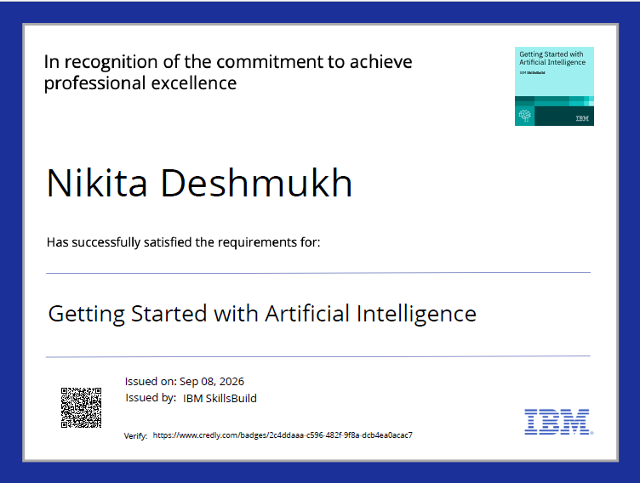
Certificates Earned:
Please add your credly certificate

Slide 11
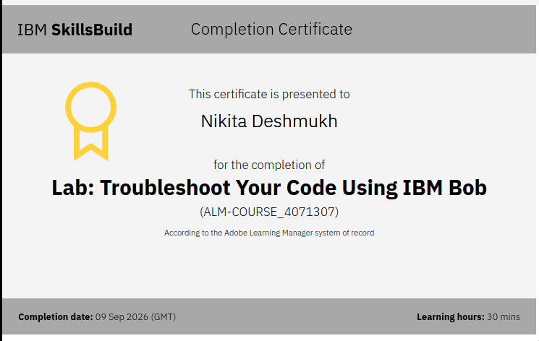
Certificates Earned:​
Add your IBM BOB Certificate

Slide 12


